Slide 1
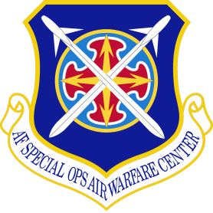

United States Air Force
Special Operations School
(USAFSOS) Regional & Cultural Education
Mrs Susan Alaniz
Chief, Theater Engagement Division
Homepage: www.afsoc.af.mil/usafsos
Blackboard Learning Mgmt System: https://afsoc.blackboard.com
USAFSOS Student Support: COMM 850-884-4757/4758; DSN 579-4757/4758
Jan 2015
Notes:
AFSOC’s only formal school conducting special operations education, language training and professional development
Develops, schedules, and executes joint education – 7390 students in FY14
Implements AFSOC/CC and Commander USSOCOM educational strategy
Conducts resident and off-station courses in joint/combined special operations, SOF command and control, cultural/geopolitical regional orientation, counterinsurgency, irregular warfare, and force protection
Conducts language training and proficiency

Slide 2
Overview
USAF Special Operations School Mission
Focus on Regional/Cultural Education Capabilities
Requested Discussion Topics

Slide 3

School Origins
1967-83
1983-90
Founded:
  [1963-66 – USAF COIN Course, Air University]
  Apr 67 – Special Air Warfare School
  Jul 68 – USAF Special Operations School
  Feb 13 – Special Operations Air Warfare Center
1990- Present
Notes:
3

Slide 4
USAFSOS Mission & Vision
Mission: Deliver responsive and relevant education, to enable Air Commando excellence in complex and ambiguous operational environments world-wide
Vision: To be the elite institution providing air-centric, SOF-focused education to USSOCOM, USAF, and US Government personnel
Train for Certainty…Educate for Uncertainty!

Slide 5

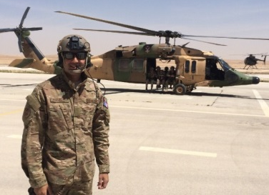
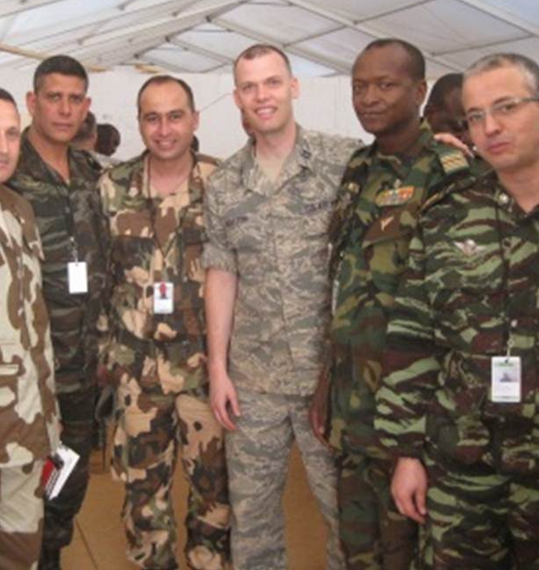
Faculty Credentials
Career SOF aviators -- weapon systems & operational experience
Dean of Academics–PhD in Educational Technologies & Leadership
Naval Postgraduate School graduates
  Degree holders in National Security Strategy, Special Operations & Low Intensity Conflict, Defense Analysis
Support career field expertise represented
  Intelligence / Cyberspace Warfare / Security Forces / EOD / OSI
PhD Candidate in International Development
Regional Affairs Strategists & Political Affairs Strategists (RAS/PAS)
  Widespread experience living and working in international contexts
  Resident skills in 32 languages
“Full service” Language Center – initial, continuation skills training, deployment prep
AFPAK Hands & MAVNI personnel
Notes:
As mentioned earlier Faculty Credentials management is a core activity under the office of Institutional Effectiveness. USAFSOS maintains a SME professional mix of military, civilian GS and contractors with advanced degrees. Given our focus on Operational Military Education (OME), USAFSOS employs a significant number of operational military and outside professional expertise as guess lecturers. This is consistent with our contention that the SOF community is our curriculum. Also, USAFSOS has been endowed recently (over the past 3 years) with its MAVNI airman cadre who provide LREC expertise critical to our education mission. The MAVNI acronym equates to Military Accessions Vital to National Interest.

Slide 6
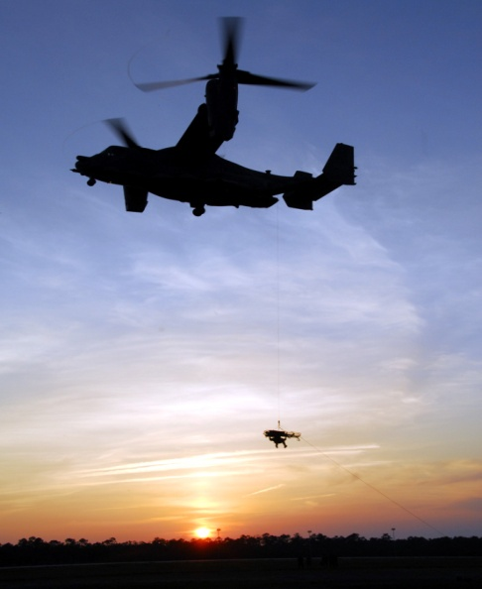
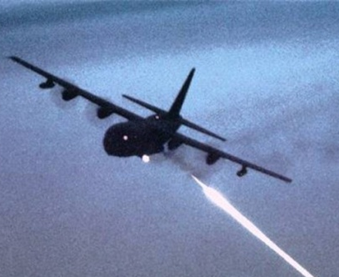
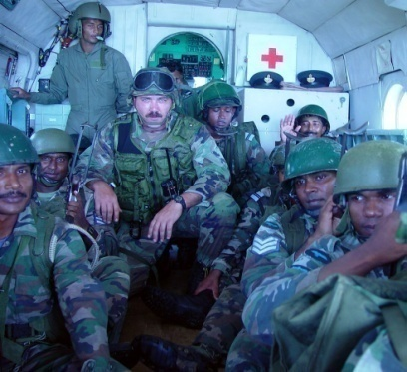
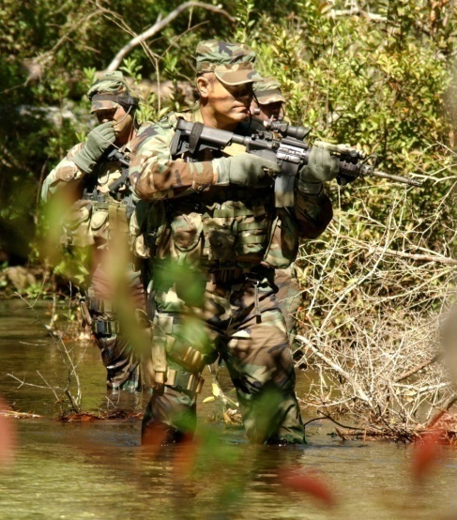
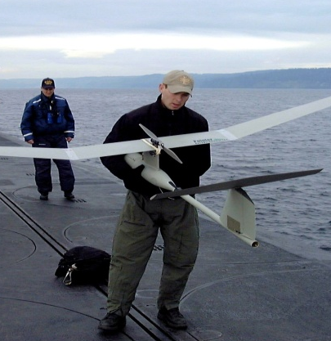
AFSOC Core Missions
Precision Aerospace Fires
Specialized Air Mobility
Specialized Refueling
Aviation Foreign Internal Defense
Intelligence, Surveillance, and Recon
Information Operations
Psychological Operations
Agile Combat Support
Command and Control
Battlefield Air Operations
Notes:
- Ten core AFSOC missions—REC education must be delivered with context need awareness
Nearly 18,000 AFSOC airmen—about 5,000 are aviators
Many new aircraft and weapon system missions in last 15 years
On any given day—deployed to 30 different countries in various stages of political development and relationships with the United States
Requires instructors to constantly examine the question—what is SOF? Specialized capabilities with specialized knowledge. Regional and cultural education is at the heart of that specialized knowledge.
AFSOC Core Missions

Slide 7
Academic Divisions
Operations
Irregular Warfare
Language Center
Theater Engagement

Slide 8
Air Commando Education
Air Commando Education Continuum
Task/Course | Level 1 – All, CMR | Pre-Deployment Training | Level – 2 Aircraft Commander/Instructors | Level 3 – Mission CC
Level | Air Commando 101 |  | Air Commando 201 | Air Commando 301
Completion Mechanism | Required prior to AFSOAWC FTU graduation | Required by AFSOC before deployment | Required prior to Group/CC certification | Required by Wing/CC before assuming MC duty
Education
Culture | ICSOF – (1 day seminar)² |  | Full ICSOF (4.5 days)
Regional Education |  | Regional Mobile Education Event (MEE) (1-3 days)² | Full Regional Course (4.5 days)²
Ops Education (required) | ISOC (2.5 days) ¹ |  | Elective⁷ | Mission Commander’s Course (3 days) ³
Interagency |  | COMREL (2 hours) | IASOF (2.5 day)
Electives
Language | 40 hours language training⁶
Ops Education |  |  | SOFAC2 (4.5 days)⁵
 |  |  | INSOF⁵ (4.5 days)
Irregular Warfare |  |  | DIT (4.5 days)⁴ | ROC (4.5 days)⁵
 |  |  | CIWC⁵
Items in Orange are new initiatives or courses, all others currently exist but are either not required or the requirement is not enforced.
Currently mandatory for LTFW community with expansion plans across all AFSOC SOF for life career fields
Notes:
-Unique pipeline requirements—emphasis is on tech qualification
--Few are ‘SOF for Life’
Education must serve wide range of capacities from A1C to general officer with little experience to decades

Slide 9
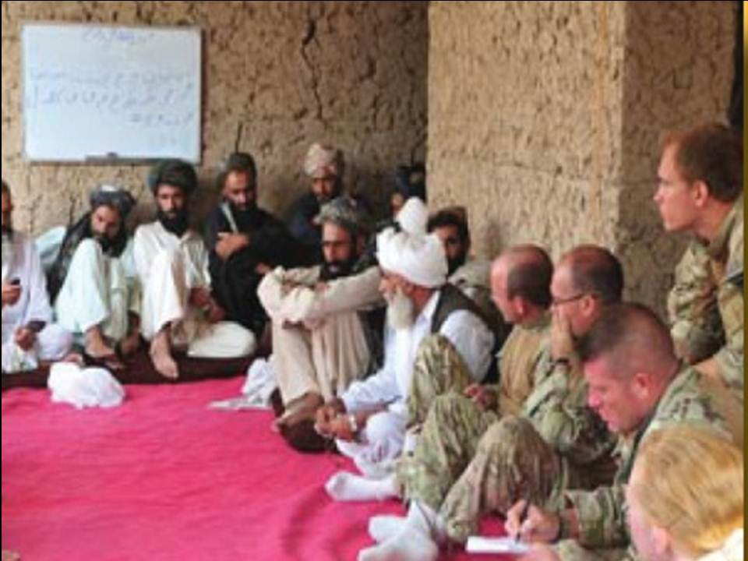
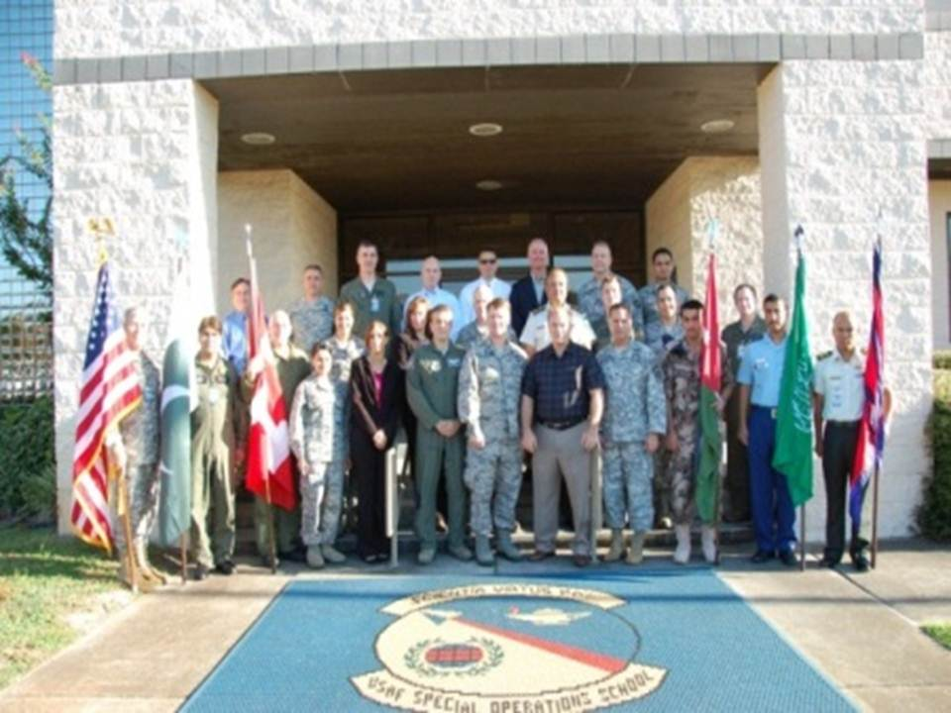
Theater Engagement Division
Intercultural Competence Basic Course (ICBC)
Intercultural Competence Course (ICSOF)
AFRICOM Theater for SOF (ATSOF)
CENTCOM Theater for SOF (ETSOF)
EUCOM Theater for SOF (ETSOF)
PACOM Theater for SOF (PTSOF)
SOUTHCOM Theater for SOF (STSOF)
Building Partner Aviation Capacity Seminar (BPACS)
Notes:
SOED-TE is a Total Force division. Our mission is to prepare SOF personnel to optimize personal relations and planning functions with partner nations in the unique political environments that characterize special operations. We conduct COCOM orientation in formal courses and provide customized pre-deployment country specific focus, as requested. Courses cover COCOM/TSOC mission priorities, and relevant history, politics, economics, and social topics expected to impact SOF mission effectiveness. Conducts DoD’s only joint, interagency course on Aviation Enterprise Development
- Basic–
Intercultural Competence:
Cultivating self–awareness: Recognize the invisible cultural influences that frame and guide habitual ways of thinking and behavior.
Understanding deep culture: Describe how collective identities embedded in shared historical memories manifest themselves and evolve in times of political crisis.
Building cultural fluency: Learn how to navigate cross-cultural differences and turn them into opportunities for constructive relationship building, especially in volatile areas.
- Intermediate and Pre-deployment for all
-- Country and regional context
BPACS– Advanced
-- Increases knowledge of partner nation aviation context—wide range of how aviation managed
-- Also builds engagement skills with current PN aviation decision makers in seminar environment

Slide 10
Theater Engagement Learning Objectives
1. Relevant U.S. national security interests, foreign policy objectives and military strategy in XXCOM
2. Relevant historic, geographic, demographic, social, political, economic and cultural factors within the XXCOM AOR
3. The mission, organization, priorities, operations, and challenges of the Theater Special Operations Command, general purpose forces, interagency and international organizations
4. Per TSOC priorities, the nature of select XXXCOM partner nation militaries and paramilitaries, particularly the Air and SOF components, where applicable
5. The organizational structure and policy for the XXCOM AOR Department of State political/military affairs
6. Relevant contemporary security issues faced by select countries and sub-regions within XXXCOM
7. Strategies for effective intercultural communications in the XXCOM AOR
8. Key international players and partners in XXCOM AOR

Slide 11
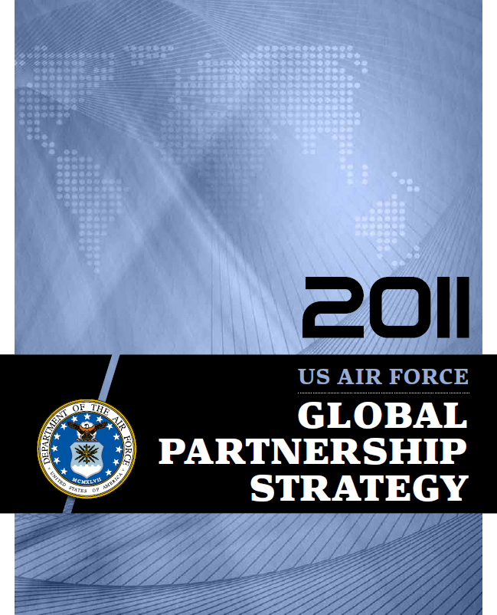
US Support for
Host-Nation
Programs
Interagency
Coordination
Military Roles
and Missions
Defense, Diplomacy,
& Development
Building Partnership Aviation Capacity Seminar Topics
Civil-Military
Relations
Civil Aviation
Management
Economic
Development
Disaster Relief
Building Partner
Capacity
US Embassy
Country Teams
Border Protection

Slide 12
Discussion Topics
How Training/Education is Recorded:
  School Registrar
  All Formal Courses have Codes
  Attendees Receive Certificates
  Becomes part of student training/education records
Program Challenges:
  Policy toward attendance and available student time for REC learning
  Mix of active duty, reserve, civilian and contractors—both a strength and a challenge– need continuity, but credible operational experience/understanding
Current Research Initiatives
  No formal research efforts
  Informal efforts in Aviation Security Cooperation, Optimizing Mobile Education, and Distance Learning
Suggested Inter-Organizational Collaborative Efforts:
  Need a central database for key organizations with strengths listed and associated contacts
Notes:
Challenges:
-- Mix of classified/sensitive information
-- Cdr emphasis on tech qualification versus pol/mil awareness—new policy is helping
-- Small staff

Slide 13
Discussion Topics
Ideas that could enhance organizational efficiencies:
  Central funding source to pay for organizational collaboration
Suggested strategy for building capability to close gap in requirements:
  Continue to emphasize importance at Corona conference
  Keep operational deliverables in mind versus glittering generalities

