Slide 1
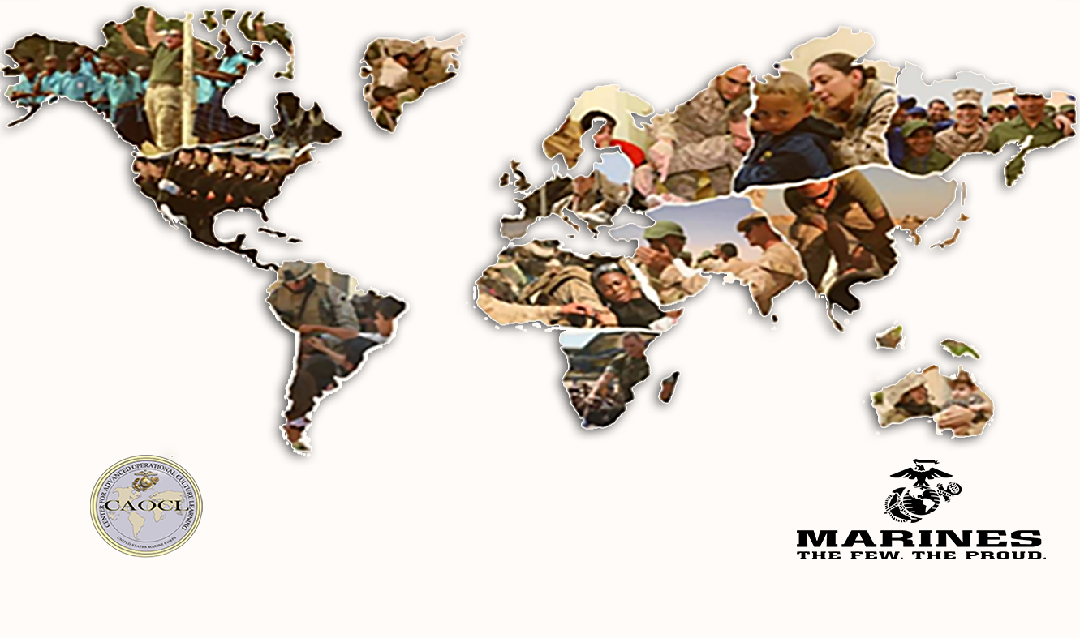
Regionally Focused, Globally Prepared

Slide 2
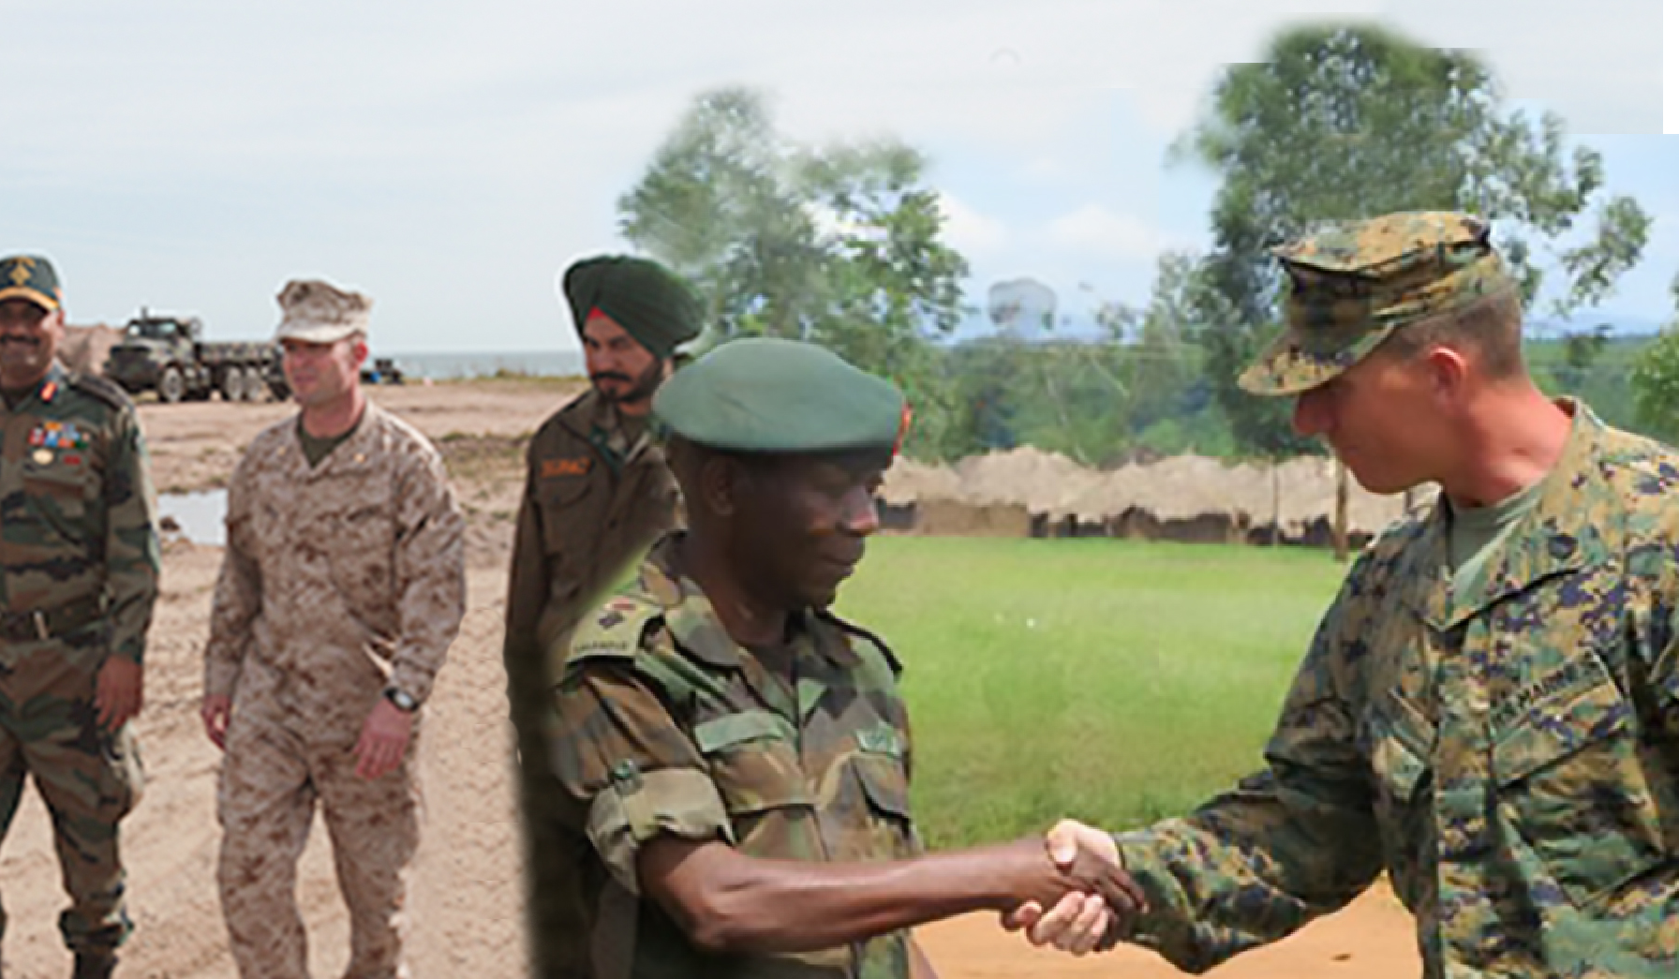
CAOCL – Who We Are and What We Do
DOTMLPF
INSTITUTIONALIZATION
SERVICE STANDARDS
The Center for Advanced Operational Culture Learning (CAOCL) serves as the central USMC agency for operational culture education and training and language familiarization programs and issues across the DOTMLPF combat development pillars.
DOCTRINE
EDUCATION
RCLF PROGRAM
FORMAL SCHOOL SUPPORT
TRAINING
PRE-DEPLOYMENT TRAINING TO 45,000+ MARINES ANNUALLY
OPERATIONAL SUPPORT
DIRECT SUPPORT TO
THE OPERATING FORCES
(CULADs)
TRANSLATIONAL RESEARCH
FIELD SOCIAL SCIENCE RESEARCH

Slide 3
LREC Partners
PP&O
Regional Expert Focus
USMC LREC
DIRINT
Language Professional Focus
SLA
CAOCL
General Purpose Force Focus

Slide 4
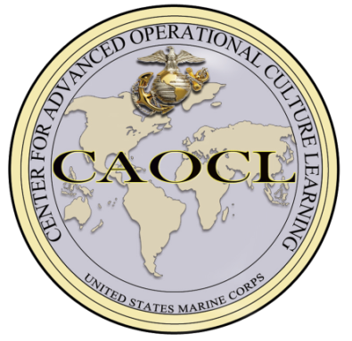
CAOCL Linkages
MCU
RCLF
CMO
Operating Forces
Advisor
TRNG & Education
Military Occupational Specialties
TRADOC Culture Center
MCIA
FAO/ FAS
MCESG
U.S. Army
DLNSEO
SWC/ IWID
Capabilities
Reach-back
U.S. Navy
LREC Strategy
LREC
DOTMLPF
CLRC
U.S. Air Force
DIRINT (SLA)
T&R Manual
CULADs
Doctrine
PP&O
MCFDS
AFCLC

Slide 5
USMC GPF Approach
Adapted to be relevant to the USMC
A warfighting tool
Big C little l
Mutually supporting Career long education and pre-deployment training
Global force, Global program

Slide 6
LREC Conceptual Framework
Culture General
The relevant characteristics and trends of a particular geographic area or population
Concepts and skills that may be applied to a range of areas and missions.
Regional / Culture Specific
Functional
Language
Unifying theme:
Provide a foundation in cross-cultural competence to support a globally deployable force while simultaneously enhancing regional understanding and functional language/communication skills throughout the OPFOR.
Memorization of key words and phrases that support mission accomplishment.
Building a foundation for Cross Cultural Competence
Notes:
Use language slide (4 bubbles) as a backup

Slide 7
Training
Increasingly diversified – NOT an OEF / OIF bi-product
51,958 Marines trained through 30 June of FY 15
751 individual training events during this ssame period
Over half of CENTCOM-related training does not have OEF focus
Shift to the Pacific
CAOCL Training:
Global capability with regional focus
Scalable, responsive, adaptive
Culture, region, and language
Classroom instruction
Training Support:
Scenario design
Field assessment
Mission rehearsal exercises

Slide 8
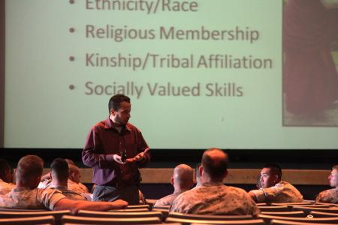
Education
Professional Military Education (PME)
Operational Culture Lectures and Products: Support formal education
(Marine Corps University) through classroom instruction and discussion
Exercise Support: Provide Cultural Subject Matter Experts (SMEs) to
incorporate operational culture into planning process
Green Cell: Support MCU with classes, scenario design, and practical
exercises
Formal Schools
Operational Culture classes &
exercise support
Electives
Regional, Culture, and
Language Familiarization
(RCLF) Program

Slide 9
RCLF Program Highlights
Global Expeditionary LREC Capability
“Culture General” core curriculum enhanced by regional case study and language familiarization focused in the military domain
Provides a 3C capability distributed across the force
Not linked to manpower assignments
General Purpose Force (GPF) Program
Applicable to entire career force - Sergeants and above
Active and Reserve Component
RCLF completion required PME complete for rank
Self-Paced Distance Learning Model (MarineNet)
Downloadable materials
Computer Based Training modules
Web-site hosted resources
Notes:
Self-explanatory

Slide 10
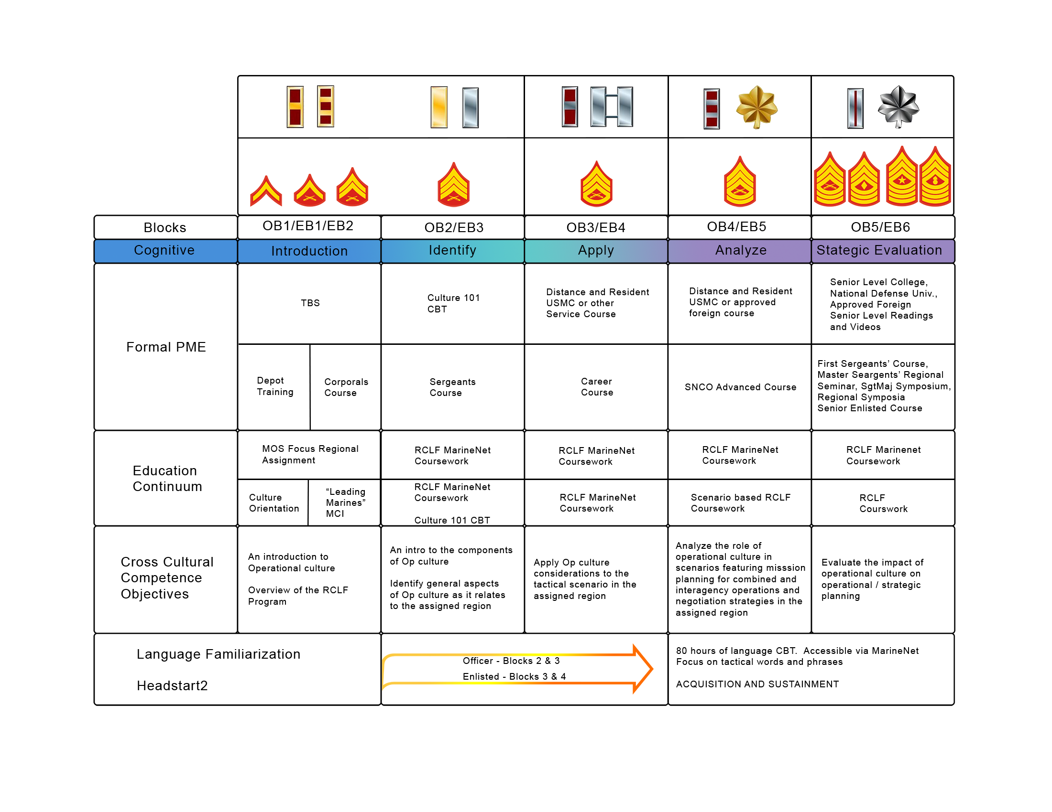
Regional, Culture, and Language Familiarization (RCLF) Program

Slide 11
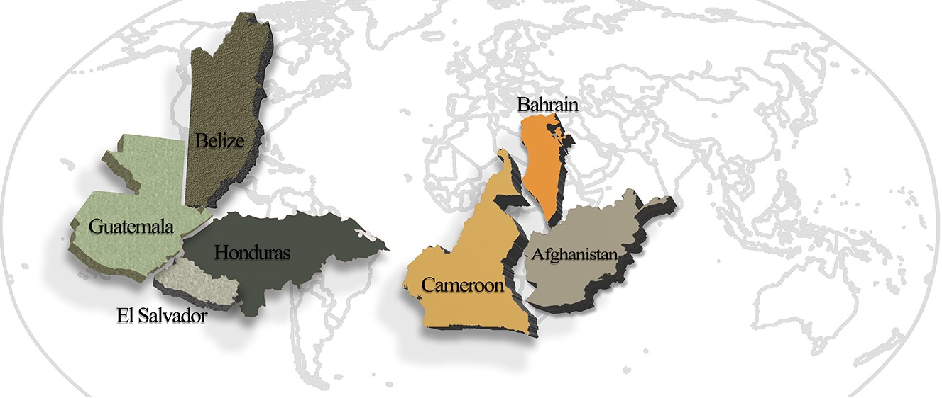
Cultural Advisors
Cultural Advisor
Cross-cultural Expertise
Exceptional Multi-language Skill
Executive-level Cultural SME
Reach back
Integrated into the Planning process

Slide 12
Institutionalization
Legacy Documents
Current Initiatives:
CAOCL Charter dtd Jan 2006
DoD LREC Strategy 2011-16
USMC LREC Strategy 2011-15
MROC Decision Memo RCLF 2012
MARADMIN 619/12 – RCLF (AD)
CJCSI 3126.01A – GCC LREC Req
MARADMIN 196/13 – RCLF (Res)
CBRIP LREC 2013
MARADMIN 231/14 – RCLF Lang
MOU TBS 2014
MOU EPME 2014
MCWP 3-33.5 Insurgencies and Countering Insurgencies
Foreign Area SNCO (FAS) MOS Manager
MCIP 3.44-01 Applied LREC for Expeditionary Operations
NAVMC 3500.65A – Language, Regional Expertise & Culture T&R Manual
USMC LREC Strategy 2016-2020
JCA 8 Building Partnerships Concept and CBA
CMC CAILS 2015
Small Wars Manual 21
Expeditionary Force 21

Slide 13
USMC LREC Strategy 2016-2020
Currently at 3-Star staffing
Builds upon USMC LREC Strategy 2011-2016:
Established LREC awareness, coordination, and creation of roles and responsibilities for Service stakeholders
USMC LREC Strategy 2016-2020:
Integrates Service stakeholders based upon CJCSI 3126.01A: LREC Capability Identification, Planning and Sourcing of 31 Jan 2013
Further develops and matures LREC capability across Service and with Joint partners

Slide 14
2015 CMC CAILS Initiative
Combined Afghanistan Iraq Lessons Study
Research reviewed over 1700 pieces of service-related literature over past 10 years of conflict
Identified 345 observations, insights and lessons (OILs) within over 600 cited sources.
LREC OILs were pervasive throughout the research themes:
Understanding the Operational Environment
Leadership and Supervision
Training and Education
Readiness
"Marines indicated they valued Language, Regional Expertise and Culture (LREC) capabilities; and that those capabilities were important to mission effectiveness and were fundamentally critical to achieving operational effectiveness in both Iraq and Afghanistan. Lessons from Iraq and Afghanistan indicated that Marines trained in these capabilities thought they were more operationally effective."
- CMC CAILS 2015

Slide 15
Translational Research Group
Experimental capacity: original intent - provide in-house social & behavioral science capacity ISO problem scoping, decision-making for CAOCL and other USMC organizations
Problems in DoD Research:
Academic projects often too abstract, disconnected
Applied projects often lose scientific rigor/accuracy
S&T supported research focuses on tech transfer not knowledge transfer
Across the board researchers lacked ongoing connection to Marines, the operational context, and the machinery of institutionalization
Approach: Translational research characterized by tight collaboration between scientists and practitioners
Interdisciplinary team – focus on fields scarce in DoD
Research designed in coordination with Marines
Researchers in daily contact with Marines gain understanding of operating context and institutionalization processes
Free to focus results on transferring knowledge to Marines and the supporting establishment
Programs and curricula based on sound science are more sustainable and measurable – you can’t measure buzzwords

Slide 16
Current Research Initiatives
The Ebola 100 Project (2015)
Perspectives on creative problem solving (2015- 20xx)
Perspectives on Project Welcome Home Troops’ Power Breath Workshop (2014-present)
Longitudinal Assessment of culture and language instruction in security cooperation training, and mission effectiveness (2013-present)
Training and Education Command Resilience Research Project (2012-present)
Notes:
a) Ebola 100- a collaborative project among non-profits, civilian universities and CAOCL to interview a minimum of 100 individuals (including Marines and other military) who were or are presently involved in the humanitarian response to the Ebola epidemic in West Africa in order to produce a “living database” of experience and lessons learned
b) Creative problem solving- this research will be conducted in support of MCU’s Quality Enhancement Plan. CAOCL will interview current and former MCU students, commanders and key stakeholders in order to provide feedback about the strengths and deficiencies in Marine problem solving capabilities
c) Power breath workshop- an in-depth exploration of one program that aims to help veterans suffering from symptoms thought to be associated with PTS
d) Longitudinal assessment- since 2013, CAOCL has produced six reports on findings from observations and interviews conducted with Marines receiving CAOCL-produced culture and language training at the Marine Corps Security Group
e) Resilience- an anthropological study based on the hypothesis that resilience and rigidity are already effects of Marine Corps training

Slide 17
Next Steps
Modernize Training and Education programs using 21st Century platforms
RCLF 2.0: Portable PME
Online training modules
Maturing RCLF
Marine Corps Order
Strategic Comms
Refinement
T&E programs Assessment process
Are we doing the right things in the right way-- to the right effect
MCIP 3-44.01 Applied Language, Regional Expertise and Culture for Expeditionary Operations
Author's draft complete, undergoing initial review by MCCDC Doctrine Division.

Slide 18
Current Issues
Will “Culture” programs survive the Post-OIF/OEF World?
What will they look like?

Slide 19
Câu hỏi?
سوالات؟
Въпроси?
質問？
أسئلة
Wenti?
Питання?
Sorular?
Questions?
Dúvidas?
კითხვები?
Питања?
¿Preguntas?
Mga Katanungan?
有問題嗎？
Вопросы?
Maswali?
Asela?

Slide 20
Director CAOCL
Mr. George Dallas
GS-0301-15
Director of Research
Dr. Kerry Fosher CIV
GS-0101-14
Operations Officer
Maj Jonathan Heskett
Professor of Military
Cross-Cultural Competence
Dr Lauren Mackenzie
AD-07-35
Future Operations
Maj Marc Beaudreau
Education Officer
& RCLF Prgm Mgr
Maj Robyn Beaudreau
Maj Chris Dellow
Current Operations
Maj Jonathan Heskett
Supervisory Business
Manager
Mr. R. Childs CIV
GS-0301-13
TRG
Dr. F. Tortorello CTR
Ms. A. Matossian CTR
Ms. K. Post CTR
Ms. V. Jasparro CTR
Ms. B. Lewis CTR
Ms. E. Tarzi CTR
Graphic Design
Mr. J. Esquilin CTR
Instructional Design Specialist
Ms. E. Thompson CIV
Regional SME
Ms. H. Abdulla CTR
Ms. C. Kihara CTR
Ms. J. Pearce CTR
Ms. D. Slater CTR
Mr. B. Tashev CTR
Operations Chief
GySgt James Cornwell
COR and Budget
Mr. R. Hopchak CIV GS-0501-09
CULADS
Mr. M. Hijazine CTR
IT
Mr. W. Courtright CTR
Training Officer
Mr. E. Focht CTR
Admin
Ms. T. Flagg CIV
GS-0303-07
Curriculum Dev
Mr. G. Purdy CTR
Mr. G. Raney CTR
Ms. M. Spencer CTR
Mr. J. Sweeney CTR
Logistical Support
Mr. J. Bilyew CTR
Curriculum Dev
Dr. D. Hadi CTR
Mr. J. Doerr CTR
Mr. D. Koger CTR
Mrs. B. Cornett CTR
Middle East Desk
Mr. V. Liebel CTR
Ms. A. Abdeshahian CTR
Mr. S. Kerry CTR
Mr. M. Caudill CTR
LNOs
Mr. F. Dillbeck CTR
Mr. S. Middleton CTR
Mr. B. Walker CTR
Mr. R. Williams CTR
Plans & Policy
Mr. M Slater CTR
Strategic Communications
Ms. B. Ferguson CTR
RCLF Program Analyst
Mr. B. Ross CTR
Eurasia Desk
Mr. B. McLaughlin CTR
Mr. T. Hammond CTR
Asia-Pacific Desk
Mr. S. Packard CTR
Mr. Y. Needel CTR
Mr. D. Walker CTR
Mr. J. Garrepy CTR
Africa Desk
Mr. H. Bore CTR
Mr. F. Agola CTR
Mr. H. Lellou CTR
Latin America Desk
Mr. A. Mesa CTR
Mr. W. Caban CTR

