Slide 1
Navy Culture Programs
4 August 2015
UNCLASSIFIED
Notes:
This presentation is an overview of the Navy’s Center for Language, Regional Expertise, and Culture focused on the organization and its mission.
This brief was last updated in July 2015.

Slide 2
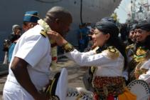
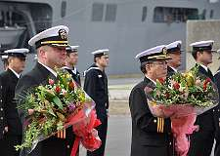
CLREC and It’s Role
  Center for LREC was established to meet the Navy’s LREC training needs to:
    Strengthen ties with enduring allies
    Cultivate relationships with emerging partners
    Thwart adversaries and
    Defeat enemies
  CLREC prepares Navy personnel to:
    Interact appropriately with people in foreign cultures
    Avoid taboo behaviors
    Avoid culture shock
Notes:
CLREC was established to develop and execute training to the Navy’s operational forces in their endeavors to:
Strengthen ties with enduring allies
Cultivate relationships with emerging partners
Thwart adversaries
Defeat enemies
As a result, CLREC deploys training geared toward preparing commands and individuals to:
Interact with people in a foreign culture
Avoid taboo behaviors and culture shock
Enhance long-standing relationships
Build trust with emerging partners
Understand adversaries

Slide 3

CLREC Tasking / Demand Determination
  How is CLREC Tasked? / How does CLREC determine demand?
    Individual Requests from the Service Member
      2691 Language Coded Billets in the Naval Information Dominance Enterprise (NIDE) (comprised of military, civilian, active, reserve and foreign hires)
      64 IS Billets (57 Active Duty, 7 Reserve)
      63 1830 (Intel) Billets (58 Active Duty, 4 Reserve, 1 Student / NPS Olmsted Scholar)
    Ship’s Movement
    Units Deploy
    Predictive Analysis
    CLREC Outreach / Pamphlets
    CLREC’s role in the Defense Foreign Language Testing Program (DFLTP)
Notes:
People receive orders, CLREC is contacted for training opportunities.
Ships move, Units deploy, CLREC gets contacted for training – there are numerous examples
Predictive Analysis: One INTEL Officer assigned to CLREC, keeping a pulse on world events.
CLREC Outreach: Making potential customers aware of CLREC products and training (similar to this presentation).
CLREC’s role in the DFLTP…next slide

Slide 4


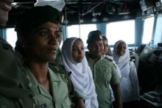
CLREC Training Solutions
Delivery Method | Cultural Orientation | Language Familiarization
Instructor-Led Group | X | X
Command-Delivered Training on DVD/CD | X
Self-Paced Navy or Joint e-Learning | X
Self-Executing Audio/Video Presentation | X
Individual Tutoring |  | X
Self-Paced Freeware, Shareware & Government Products |  | X
Commercial Products |  | X
Notes:
CLREC training programs are resourced by OPNAV and training is performed at no cost to the unit or individual supported. Language and cultural training may be delivered in a variety of ways depending on factors such as number of students to be trained, location of students, mission timelines, instructor availability, and availability of computers and other training infrastructure. Coordination with CLREC should commence at least 60 days prior to training start date to permit proper planning and funding.
Cultural Orientation training is normally instructor-led, but many commands opt to have a knowledgeable member of their own command use materials provided by CLREC to deliver the training in a GMT format. Some commands prefer training materials with voiceovers in .AVI format suitable for use over shipboard Closed Circuit Television Systems.
Language Familiarization training is often tailored to mission-specific terminology, such as phrases and words useful in Visit, Board, Search, and Seizure operations; Medical work; or Civil Affairs missions. Such training normally requires an instructor, but may be delivered to both small groups or individuals.
General Language Familiarization may be either instructor-led or self-paced using commercially procured software, government-developed programs, or materials freely available on the Internet.

Slide 5
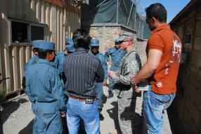

Other Training Products
  Key Leader Engagement (KLE)
    Classroom preparation
    Practical Application in simulated environment
  Language Familiarization Instruction
    Tailored to mission requirements (HADR/VBSS/COMREL)
    Instructor led
    Commercial products and materials
    Freeware and shareware links
    “Playaway” audio players
  Virtual Cultural Awareness Trainer
  Professional Etiquette Guides
  Culture Cards
Notes:
In addition to funding the continuing professional development for the Navy’s foreign language professionals - CTI and FAO personnel and DoN personnel preparing for deployments and engagements with foreign visitors, CLREC is resourced to provide senior Navy leaders with training in Key Leader Engagement or K-L-E. KLE training is comprised of facilitator-led presentations of cultural considerations followed by practical application in a simulated foreign environment with subject matter experts playing the role of foreign counterparts.
In addition to 2,200 CTIs and 300 FAOs, there are about 3,000 other Navy billets coded for foreign language (750 O; 2250 E). Technically, prior to occupying the billet, personnel must be appropriately skilled in the foreign language or learn the language by attending the Defense Language Institute Foreign Language Center (DLI) in Monterey, California or in Washington, D.C. The nature of initial language training and the Navy’s distribution system make training en route extremely complex and often cost prohibitive. To solve this, CLREC has been authorized to establish tailored language training opportunities on-site for personnel assigned to language-coded billets. Contact CLREC for more information.
Language skilled personnel serving in key positions OCONUS advance the Navy mission, strengthen international cooperation, and enhance relations between the Forward Deployed Naval Forces and the host nation’s community. CLREC can coordinate and resource specialized language and cultural training for Flag Officers, Commanding Officers, Executive Officers, Chiefs of Staff, Command Master Chiefs, and other personnel in key positions upon receipt of orders or after arrival in country.
CLREC also provides LREC training materials in support of all Sailors’ personal and professional development.

Slide 6





On the Horizon
Development of web-delivered products
  Language Familiarization
  Technical Language Translation Tools
  Operational Cultural Awareness
Development priorities
  Force Demand
  FDNF / NECC Concentration Areas
Notes:
In FY 15 and beyond, CLREC will migrate a number of the Operational Cultural Awareness Training and Language Familiarization products to Navy e-Learning, Joint Knowledge-Online, and other web-based learning portals. New course development priorities are based on Fleet demand, locations of Forward Deployed Naval Forces, and overseas Fleet concentration areas.
The next generation of our training will be e-learning courses called Navy EDGE Courses. EDGE is an acronym for “Every Deployment - a Global Engagement”. Currently, a prototype version of Bahrain EDGE is available via Navy e-Learning and EDGE courses for South Korea and Japan are under development.

Slide 7
Sample of Products
  Operational Cultural Awareness Training (OCATS)…Bahrain example follows the EOD Terminology Tool
    85 Approved Products
  Navy Every Deployment a Global Engagement (EDGE) product (Bahrain example)
    On line beefed up OCAT version
    Viewed by over 800 Sailors
  Professional Etiquette Guide
  Culture Cards
  Additional Products
Notes:
Additional products have been created by CLREC over the years and have been viewed by thousands of people. “Introduction To Islam”, a product that has been seen by Christians, Muslims, Chaplains and Imams; always received excellent reviews. Another example: “Proper Handling of the Qur’an”.

Slide 8
85 Approved OCATS
Afghanistan
Albania
Algeria
Anguilla
Argentina
Australia
Azerbaijan
Bahrain
Bangladesh
Benin
Bolivia
Botswana
Brazil
Bulgaria
Burma
Cambodia
Canada
China
Columbia
Costa Rica
Croatia
Cuba
Cyprus
Denmark
Dominica
Egypt
Equatorial Guinea
Eritrea
Ethiopia
Gabon
Georgia
Germany
Ghana
Greece
Grenada
Guam
Guinea (formerly French Guiana
Honduras
Hong Kong
Indonesia
Ireland
Israel
Italy
Ivory Coast
Jamaica
Japan
Kenya
Laos
Latvia
Marshal Islands
Martinique
Mauritus
Mexico
Micronesia
Montserrat
Mozambique
Panama
Papua New Guinea
Philippines
Poland
Puerto Rico
Republic of Congo
Russia
Saint Lucia
Saudi Arabia
Sierra Leone
Singapore
Slovenia
Somalia
South Korea
Spain
St Kitts & Nevis
St Vincent and the Grenadines
Switzerland
Syria
Thailand
Timor-Leste
Togo
U.A.E.
Uganda
Ukraine
Uzbekistan
Vanuatu
Venezula
Yemen

Slide 9
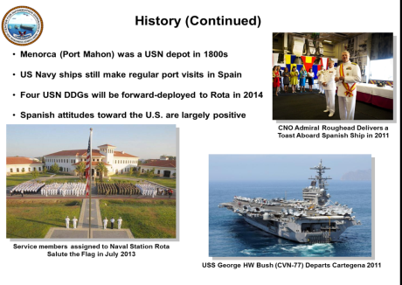
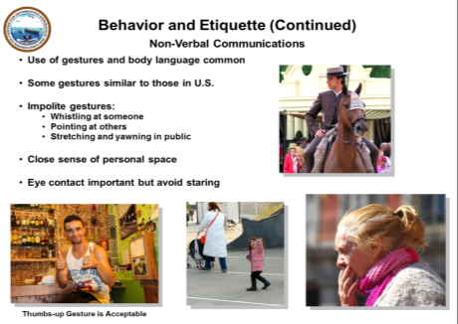
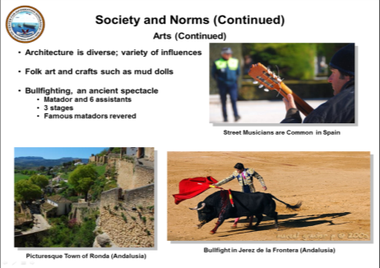
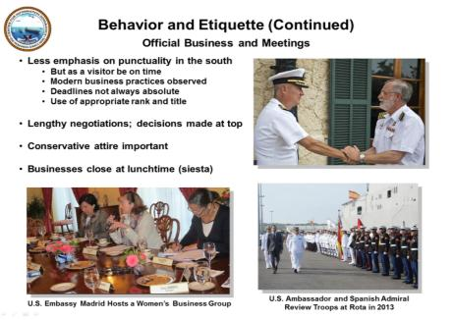
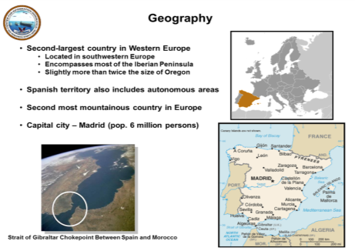

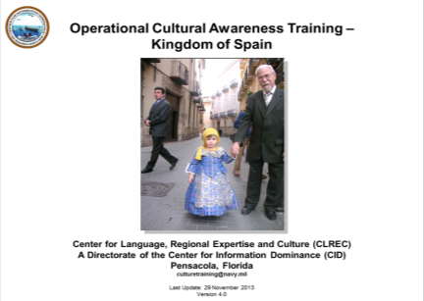
Operational Cultural Awareness
Training (OCAT) Modules
Does not replace Rules of Engagement, Intel or Naval Criminal Investigative Service Port Briefings!
Notes:
The Operational Cultural Awareness Training Brief or OCAT is CLREC’s baseline cultural training product available to Navy personnel and to other services and agencies. These power point presentations have been researched and produced by Department of the Navy program analysts on staff at CLREC. They are available on over 280 countries and summarize many important facets of each nation, its peoples, and their cultural beliefs and practices. CLREC highly recommends the CLREC presentations on Cross Cultural Competency and Culture Shock be completed prior to reviewing a country-specific OCAT.
The OCAT is currently designed and delivered in three formats:
a flat, power point presentation (.PPT) for a facilitator to use the notes pages as a script and guide while presenting the slides to a group of learners;
an audio-narrated, self-executing power point show (.PPS) that can be delivered via computer or intranet to individuals or the entire command; and
a video presentation (.AVI) for use over ships’ Closed-Circuit Television Systems or DVD players
Each OCAT covers 8 main topics; Geography, History, Peoples and Ethnic Groups, Languages, Religious Influences, Society and Norms, Behavior and Etiquette, and a Cultural Summary.
Information included in OCAT presentations does not countermand or supersede established Rules of Engagement, Intelligence Briefs, or Force Protection/Port Security Briefs provided by an Operational Chain of Command or the Naval Criminal Investigative Service.

Slide 10
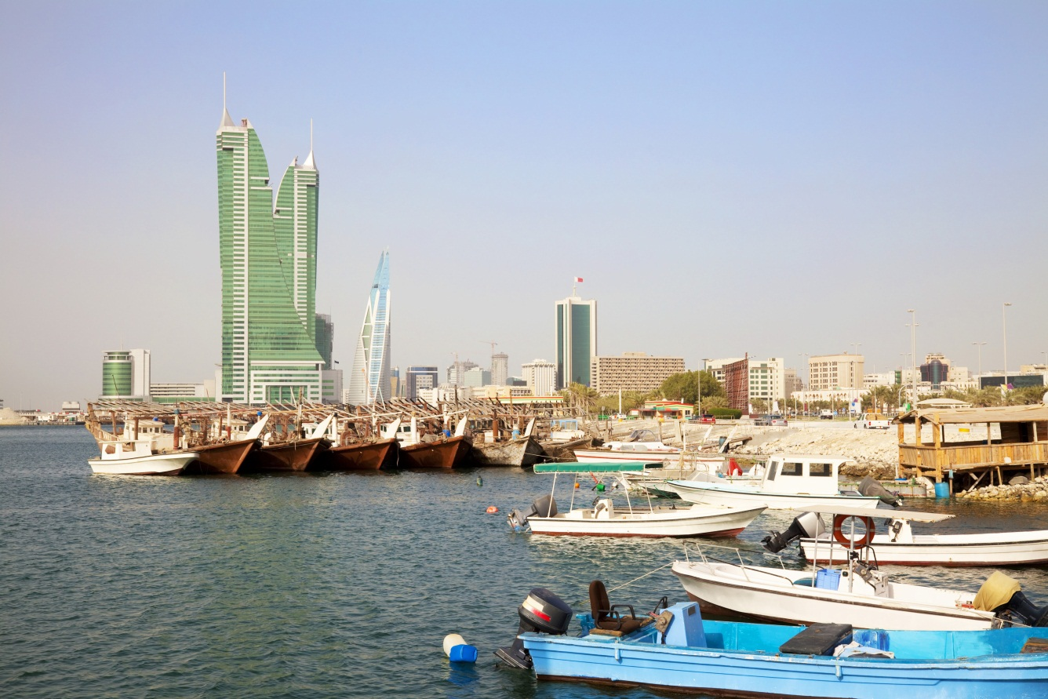
Operational Cultural Awareness Training –
Kingdom of Bahrain
Center for Language, Regional Expertise and Culture (CLREC)
A Directorate of the Center for Information Dominance (CID)
Pensacola, Florida
culturetraining@navy.mil
Last Update: October, 2014
Version 4.0
Notes:
Welcome to Operational Cultural Awareness Training for the Kingdom of Bahrain. This presentation was prepared by the Center for Language, Regional Expertise and Culture, a Directorate of the Center for Information Dominance, Pensacola, Florida and was last updated in October of 2014.
[Contact CLREC at culturetraining@navy.mil if you have any questions or comments about this presentation.]
10

Slide 11

Introduction and Overview
The purpose of this Operational Cultural Awareness Training is to familiarize you with the foreign culture presented.
For this training, “culture’ is defined as ‘the values, beliefs, behaviors, and norms that shape and reflect the basic worldview and way of life shared by a group of people.”
Overview
The following characteristics of Bahrain and its people will be presented:
    Geography
    History
    Peoples and Ethnic Groups
    Language
    Religious Influences
    Society and Norms
    Behavior and Etiquette
Notes:
The purpose of this Operational Cultural Awareness Training is to familiarize you with the foreign culture presented. It is not intended to make you an expert on this culture.
For this training, “culture” is defined as “the values, beliefs, behaviors, and norms that shape and reflect the basic worldview and way of life shared by a group of people.”
When in a foreign environment, you may feel frustrated by cultural differences, unfamiliar customs, and language barriers. You may be surprised or even offended by the social norms and individual behaviors of those around you. While these feelings are normal, they must be controlled and overcome for you to operate effectively in the environment.
After this training, you should know more about the culture presented and have some understanding of how it is similar to and different from your own culture. This cultural awareness should reduce the time it takes you to adapt to your new environment and it should permit you to communicate and cooperate more effectively with the people there.
The following characteristics of the culture and its people will be presented: Geography; History; Peoples and Ethnic Groups; Language; Religious Influences; Society and Norms; and Behavior and Etiquette.
11

Slide 12

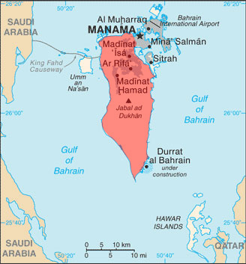
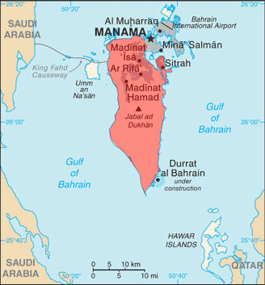
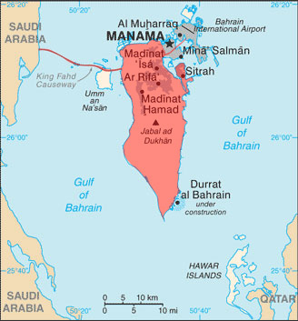
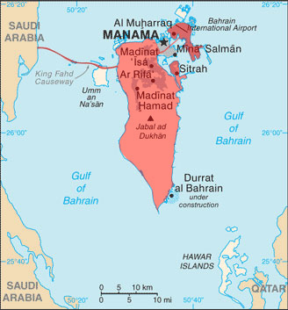
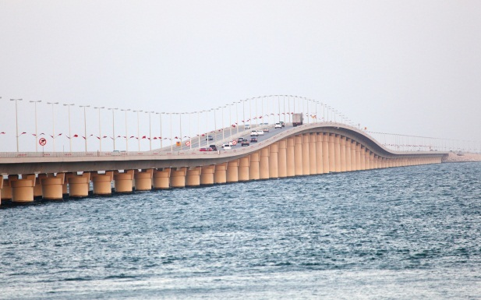
Geography
Tiny nation of 33 islands located in the Gulf of Bahrain
240 square miles, roughly 3.5 times the size of Washington, DC
98% live in Manama and Al Muharraq
Three largest islands are inhabited: Manama, Sitra, Muharraq
Causeway connects Manama to Saudi Arabia
King Faud Causeway
Notes:
Bahrain is one of the most densely populated countries in the world. Bahrain is a tiny nation made up of some 33 islands, located in the Gulf of Bahrain. The land area of the entire nation is only 240 square miles or roughly 3.5 times the size of Washington, DC. About 98% of the population lives in the two principal cities of Manama and Al Muharraq.
Only the three largest islands are inhabited. They are Manama, Sitra and Muharraq.
One causeway links Manama to Muharraq; a second causeway links Manama to Saudi Arabia. The latter is known as the King Fahd Causeway. The international airport is located in Muharraq.
12

Slide 13
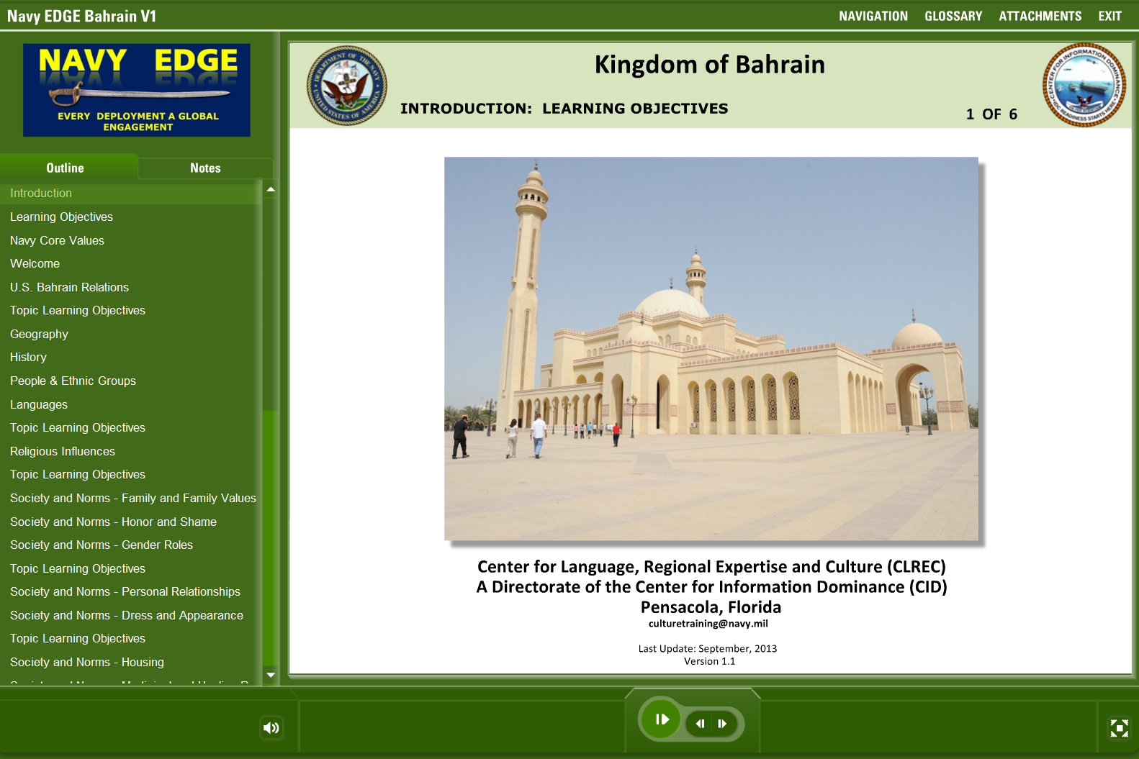
Notes:
CLREC made the Group E-Learning for Afghanistan presentation because of a request from the Naval Expeditionary Combat Command at the height of Iraq and Afghanistan wars. A requirement came in from COMISAF that all personnel deploying to Afghanistan and Iraq had to take a course called RAPPORT Dari and RAPPORT Iraq. These presentation are several hours (6-8 hours) long and are accessed through a computer (basically for individual use). NECC said they did not have the resources to send an EOD Team (100) people much less a complete SEABEE Battalion (500-1000) people through the training before deployment. CLREC created a NECC approved GEL Afghanistan and Iraq, which were used for several years by tens of thousands of NECC Sailors. CLREC also added GEL HOA.
This Navy Edge OCAT for Bahrain follows the same format and demonstrates a sample of standard CLREC products.

Slide 14
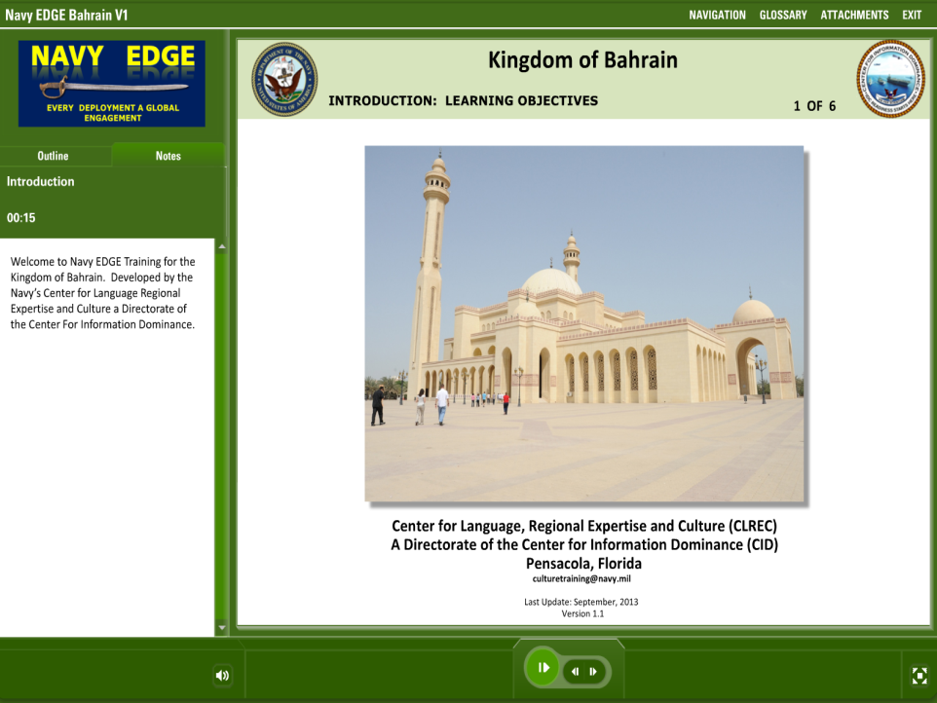

Slide 15
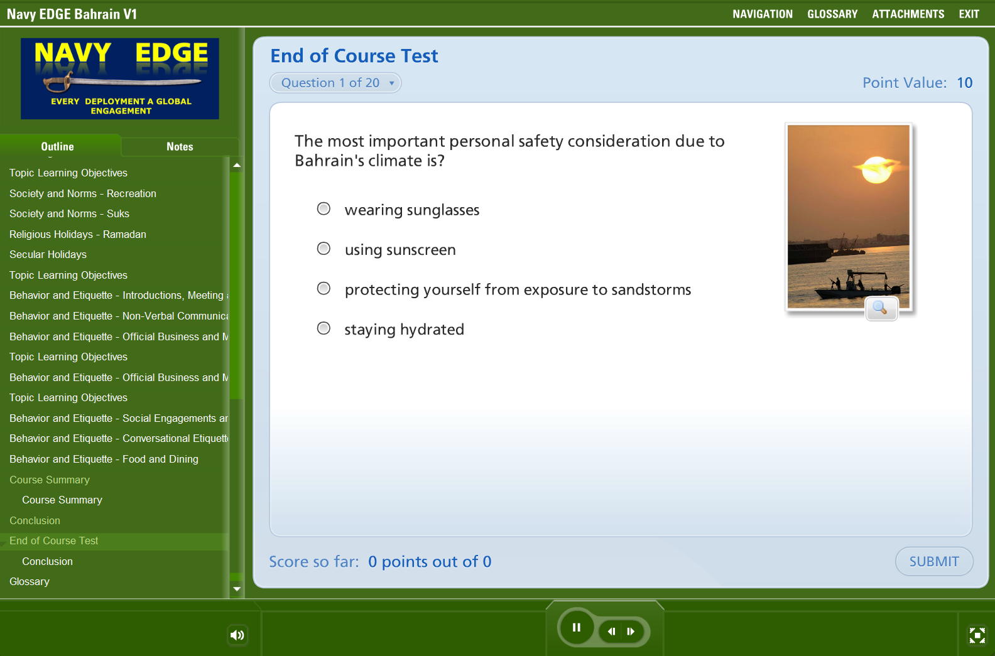

Slide 16
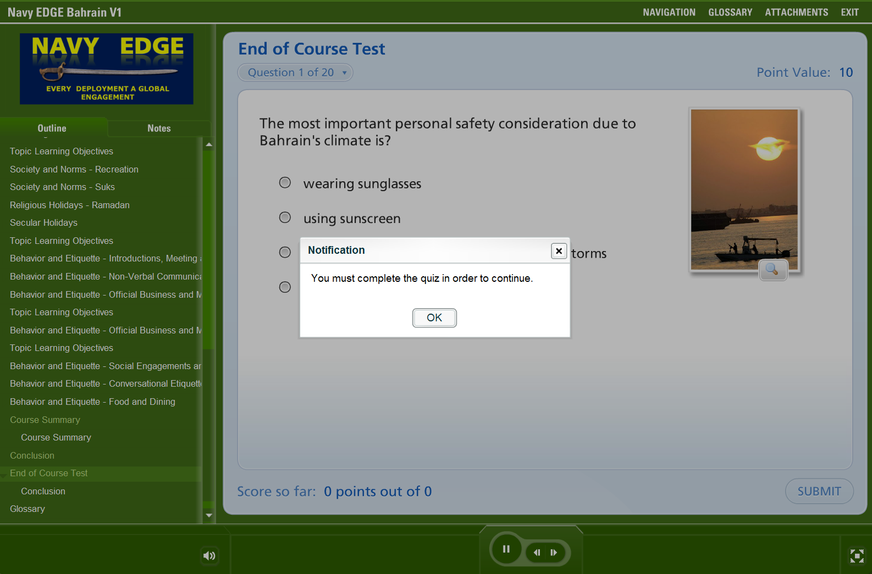

Slide 17
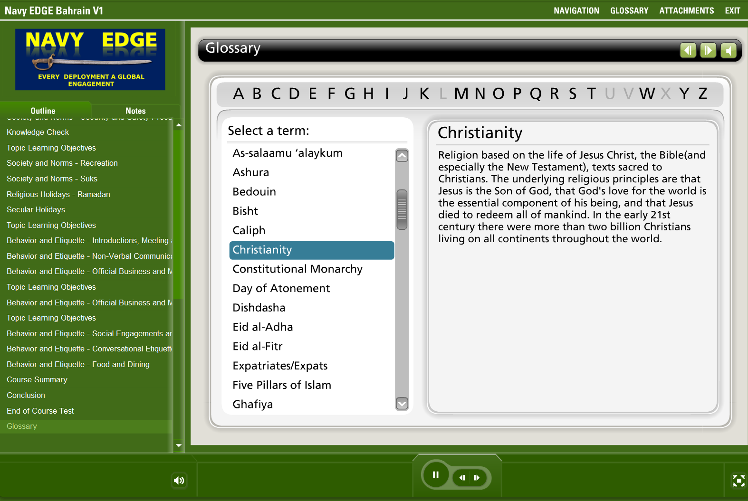

Slide 18
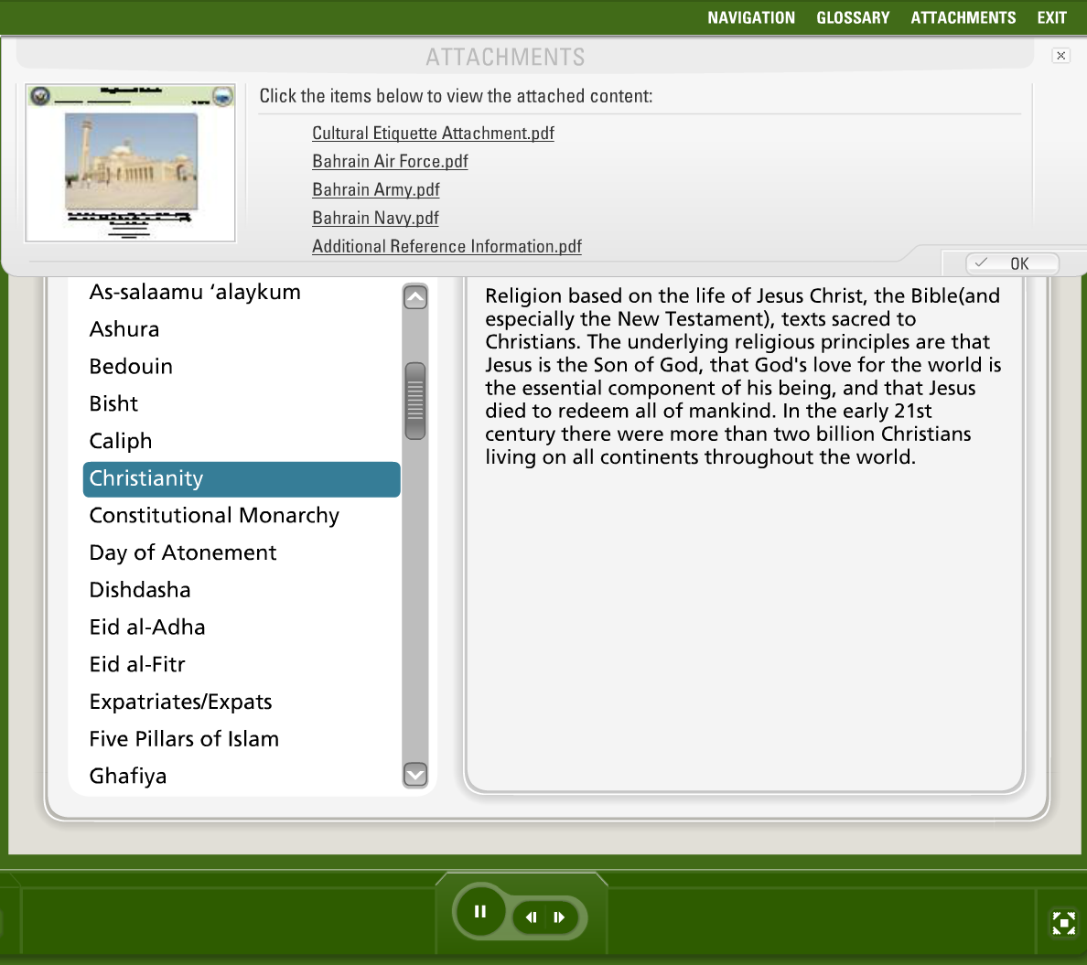

Slide 19
Contact CLREC
Director: Mr. Christopher Wise christopher.j.wise@navy.mil
IDC Integration Officer LCDR Charles Mayfield charles.mayfield@navy.mil
Fleet East: Mr. Mark Easterlin mark.easterlin@navy.mil
Mr. Scott Bond scott.bond@navy.mil
Mrs. Rhonda Gillespie rhonda.gillespie@navy.mil
Fleet West: Mr. Jim Morris james.j.morris@navy.mil
Mr. Brian Gutshall brian.gutshall@navy.mil
Mr. Travis Brummer travis.brummer@navy.mil
Expeditionary: Mr. Mike Longoria michael.longoria@navy.mil
Mr. Gary Bloesl gary.bloesl@navy.mil
CONUS/OCONUS Mr. Walt Turner walter.r.turner@navy.mil
Mrs. Lamia Rollins lamia.rollins1@navy.mil
IDFOR: Mr. Shannon Hickman shannon.d.hickman@navy.mil
Mr. Dan Garrity daniel.garrity@navy.mil
FAO: Mr. Jim Murphy james.m.murphy2@navy.mil
Mr. Dave Doughty david.s.doughty@navy.mil
DLI/FLC Quota Manager: Mr. George Sprague george.sprague@navy.mil
Language Testing Manager: Mr. Darrin Williams darrin.williams@navy.mil
languagetraining@navy.mil culturetraining@navy.mil
languagetesting@navy.mil
COMM: 850.452.6736 DSN: 459.6736
Notes:
Do you want to plan training for your command’s next deployment? Have you just received PCS orders overseas? Are you just interested in learning a foreign language or learning about a foreign culture?
Contact CLREC.
The easiest way to reach us is by email at languagetraining (all one word) at Navy dot mil or culturetraining (all one word) at Navy dot mil.
For Language Testing information, contact us by email at laguagetesting (all one word) at Navy dot mil.
Someone from the CLREC staff will normally be in touch with you within 2 business days.

Slide 20
CLREC FY 2014 Activities*
Training Statistics:
Flag Training/Support Events: 25
Foreign Area Officers: 43
Cryptologic Technicians: 458
Total GPF Personnel Trained: 14,358
Total GPF Personnel Supported: 51,765
US EUROPEAN COMMAND
TOTAL – 7,678 Supported
6 Flags
16 FAOs
108 CTIs
7,548 GPF
US CENTRAL COMMAND
TOTAL – 17,863 Supported
2 Flags
7 FAOs
145 CTIs
17,709 GPF
US PACIFIC COMMAND
TOTAL – 17,550 Supported
15 Flags
13 FAOs
117 CTIs
17,405 GPF
US SOUTHERN & NORTHERN COMMANDS
TOTAL – 4,479 Supported
2 Flags
5 FAOs
88 CTIs
4,384 GPF
US AFRICA COMMAND
TOTAL - 4,721 Supported
2 FAOs
4,719 GPF
* FY15 Activities Ongoing
Notes:
CLREC supports the specialized LREC training requirements of the Cryptologic Technician Interpretive rating and the Foreign Area Officer Community and tailors LREC training and support to the dynamic needs of the Fleet and Force performing operations, exercises, and training activities throughout the entire world.
In FY13, CLREC providing training, training materials, and other operational support in the form of translation and interpretation services to at least 52,470 Sea Service and other DoD personnel. Among this number, CLREC served 25 Flag Officer and Senior Civilians, 77 FAOs, 458 CTIs, and 145 Sailors seeking LREC for personal development. The remaining 51,765 were primarily Fleet and Expeditionary Force Sailors preparing for deployments and assignments across the globe.
(Of note: 43 FAOs participated in area/language specific training while 34 more attended the FAO Phase I Course)

Slide 21
AY 2013-2014 Naval War College
Program Activities
10,800 Sailors participated in Professional Military Education
  534 Graduated with Master’s degrees from in-resident and non-resident programs
    All achieved regional expertise level 2 (CJCSI 5160.70)
    67 chose regional electives and attained regional expertise level 3
8 US Flag / General Officers and senior civilians graduated from COSL hosted CFMCC
Program Funds supported faculty travel to:
  PACOM Planning Conference
  COIN Conference in Estonia
  International Institute for Humanitarian Law
  Western Pacific Naval Symposium in Japan

