Slide 1
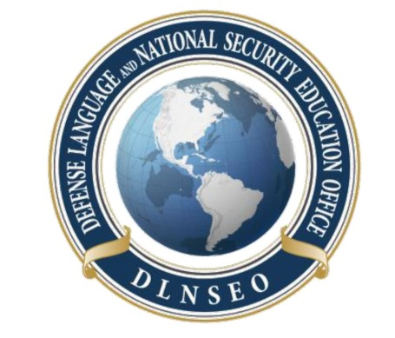
DLNSEO CULTURE TEAM
DLNSEO Culture Team
Defense Language And National Security Education Office (DLNSEO)

Slide 2
Overview
Vision
Goals
Support Products
Virtual Cultural Awareness Trainer (VCAT)
Cross-Culture Competence Trainer (3CT)
cultureready.org
(Research) Projects
Record and Report Culture Training
Culture Competency Model
Discussion

Slide 3
Vision
To provide the necessary direction to ensure a Total Force which is skilled at interacting across cultures while operating within joint, Interagency, coalition and multinational contexts.

Slide 4
Goals
Develop policies to support culture readiness across the Department
Advance culture education and training in the Total Force
Promote collaboration and partnership to create efficiencies
Support development of cultural competency in the Federal workforce

Slide 5
Support Products

Slide 6
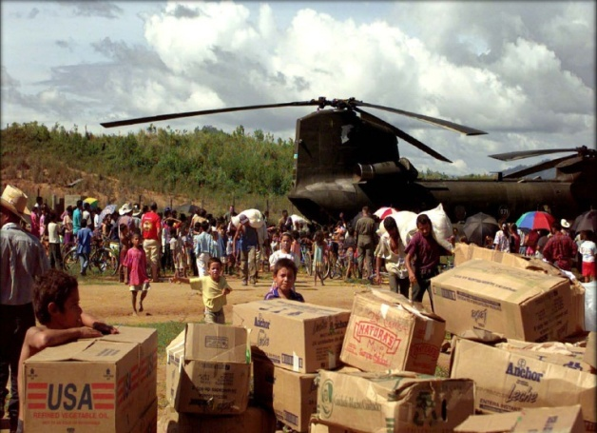
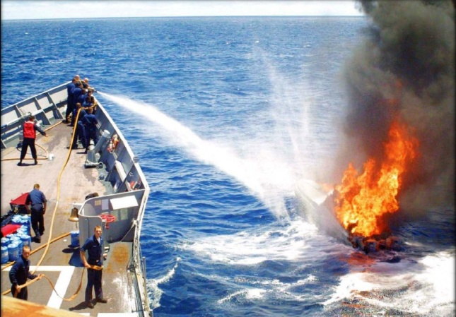
VCAT
The Virtual Culture Awareness Trainer (VCAT) provides mission-based operationally relevant culture and language training courses based on COCOM LREC mission.
VCAT lessons consist of:
Information pages
Basic Language Instruction
SME Videos
Practice exercises
Listening comprehension
Mini-Conversation exercises
Practice quizzes
End of lesson quiz
PDF takeaways
Example images used for illustrative purposes only.

Slide 7
SOUTHCOM
Regions
South America
Central America
Hispaniola
Caribbean
30 Countries
Languages
Spanish (Country Dialect Specific)
Brazilian Portuguese
Haitian Creole
Missions
Countering Transnational Organized Crime (CTOC)
Humanitarian Assistance
Senior Leader Engagement

Slide 8
SOUTHCOM

Slide 9
SME Videos

Slide 10
AFRICOM
Regions
West Africa
Northern Africa
Horn of Africa
33 Countries
Languages
Modern Standard Arabic
Moroccan Arabic
Portuguese Creole
Swahili
West African French and French
Missions
Humanitarian Assistance
Senior Leader Engagement
Subject Matter Expert Exchange

Slide 11
AFRICOM

Slide 12
SME Videos

Slide 13
PACOM
Regions
Southeast Asia
Taiwan
7 Countries
Languages
Bahasa*
Malay*
Mandarin Chinese
Tagalog*
Thai*
Vietnamese*
Missions
Key Leader Engagement
Humanitarian Assistance
Civil Affairs
Theatre Cooperation
* Language Instruction and GFI Words/Phrases - DLI Guide

Slide 14
PACOM

Slide 15
SME Videos

Slide 16
CENTCOM
Regions
Arabian Peninsula
Central Asian States
Levant*
Pakistan and Afghanistan*
21 Countries
Languages
Dari
Gulf Arabic
Modern Standard Arabic
Russian
Missions
Training with Host Nation Military
Humanitarian Assistance
Leader Engagements

Slide 17
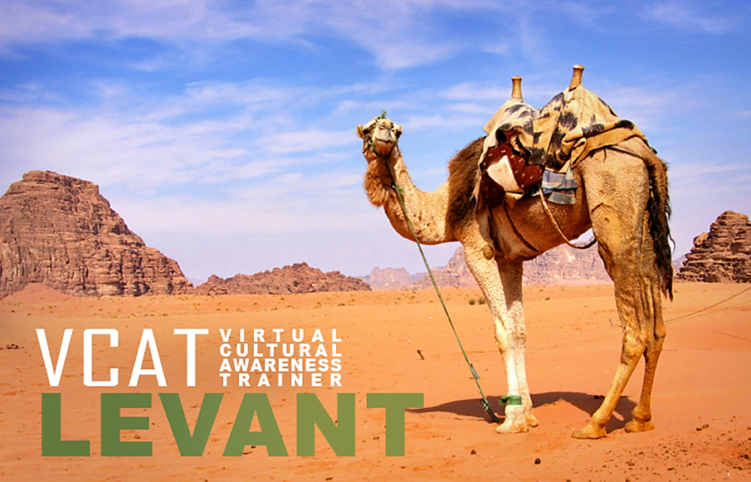
CENTCOM

Slide 18
SME Video Pages

Slide 19
What is Culture?
Required lesson for every VCAT
Based on existing culture-general learning frameworks

Slide 20
SME Video Pages

Slide 21
3CT
The Cross-Culture Competence Trainer (3CT) targets the learning objectives that encompass the culture-general knowledge, skills, abilities, and attitudes (KSAAs) that are consistent with the Department of Defense baseline of culture competencies.
“What is Culture?” – Acquiring and Applying Culture-General Knowledge
“Who am I?” – Demonstrating Cultural Self Awareness
“What makes them who they are?” – Cultural Perspective Taking
“What’s going on around me?” – Cultural Learning through Observation

Slide 22
Why Mobile?
Easy accessibility
Power and speed
Can provide “just in time” training
Quick and easy support
Notes:
− mobile devices are more accessible than traditional desktops and able to use on-the-go;
− mobile apps are streamlined for efficient and effective use, simpler navigations, reducing features that may require more download time;
− training can be rolled out much faster on mobile devices due to simpler navigation and accessibility; and
− one click access to calling helpdesk from mobile app

Slide 23
Accountability

Slide 24
www.cultureready.org

Slide 25
(RESEARCH) Products

Slide 26
Capturing Culture Training
Provide a methodology for reporting core, regional/technical, and leadership/influence competency domains
IAW CJCSI 3126.01A
Based on relevant military, professional and educational courses and training depicted in Defense and Service databases

Slide 27
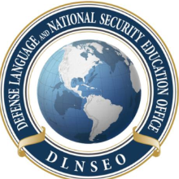
REC Readiness Inventory
Home
Inventory
Core Culture
Regional
Leader/Influence
Regional Expertise and Culture (REC) Readiness Inventory
REC-RI
Established and maintained by the Defense Language and National Security Education Office (DLNSEO)
NOTIONAL

Slide 28
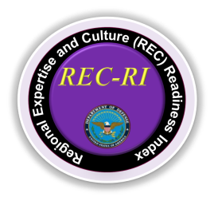
REC Readiness Inventory
Close up of the primary fields and the corresponding data elements that comprise the “Core Culture Tab”
Home
Inventory
Core Culture
Regional
Leader/Influence
Core Culture Relevant Demographic Data | Individuals
Birthplace outside of the United States | 1,000
Original citizenship non-U.S. | 15,000
Home of record outside of the U.S. | 45,000
Spouse Birthplace outside of the United States | 25,000
Core Culture Relevant Training Events | Taken
3C Trainer | 50
Village Stability Operations Academic Week | 200
Core Culture Relevant Assignments | Individuals
Security Force Assistance | 15,000
Ministerial Advisor | 14,200
NOTIONAL

Slide 29
Culture Competency Model
Develop a Competency Model
Based on study of what DoD personnel do.
Based on analysis of job-relevant experiences.
Relevant to the DoD domain.
Based on study of culture-general competence.
Identifies behaviors associated with knowledge and skills.

Slide 30
Adaptive Readiness for Culture
Adaptive Readiness for Culture (ARC) model for culture general competency
Diplomatic Mindset |  | Cultural Learning
1 | Maintains a Mission Orientation | 4 | Self-Directs Own Cultural Learning
2 | Understands Self in Cultural Context | 5 | Develops Reliable Information Sources
3 | Manages Attitudes Towards Culture | 6 | Reflects and Seeks Feedback on Intercultural Encounters
Cultural Reasoning |  | Intercultural Interaction
7 | Copes with Cultural Surprises | 10 | Acts Under Cultural Uncertainty
8 | Develops Cultural Explanations of Behavior | 11 | Plans Inter-Cultural Communication
9 | Takes Perspective of Others in Intercultural Situations | 12 | Engages in Disciplined Self-Presentation

Slide 31
ARC Model
ARC focuses on processes rather than outcomes
Challenge | Other 3C Models | ARC
Adopting a constructive mindset for working in the new culture | Focus on maintaining positive or relativistic attitude | Specifies strategies for managing attitudes and reactions
Learning about the new culture | Focus on learning as an outcome of instruction | Specifies self-directed learning practices that support knowledge acquisition, competency development, and performance improvement
Making sense of people and events in the new culture | Focus on accumulation and application of cultural knowledge to avoid surprises | Specifies strategies for creating meaning from surprising experiences
Interacting with members of the culture | Focus on display rules and engaging in appropriate behaviors | Specifies strategies for managing communication and self-presentation

Slide 32
Discussion

Slide 33
Thank You
Marc Robere Hill
marc.r.hill.civ@mail.mil ♦ 571.256.0677

