Slide 1
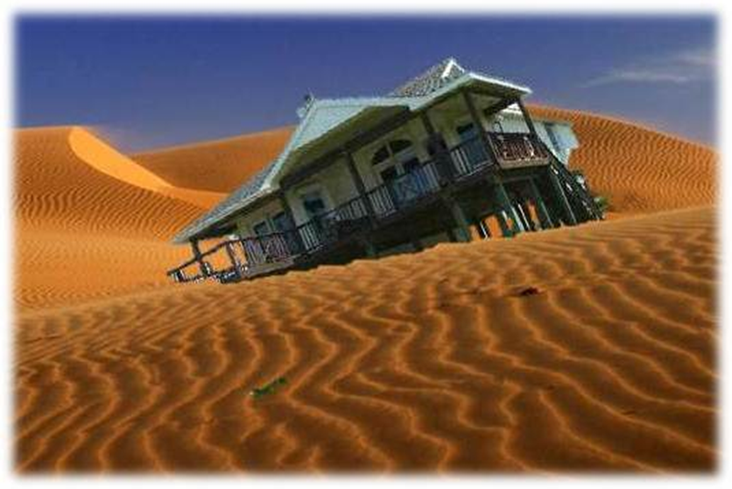
FUNDAMENTAL ISSUES IN CULTURE TESTING
Joel Koeth
Scientific Linguist
DLNSEO/NSA

Slide 2
OUTLINE
Define the problem
Core concepts
Culture-specific testing challenges
Checklist for moving forward
Discussion

Slide 3
Define The Problem
At this point, this is not a culture problem
This is a testing problem
Number of researchers involved in Culture/ LREC assessment efforts since 2001?
Number of psychometricians?

Slide 4
Define The Problem
“Culture Testing” effort to date:
CULTURE (testing)

Slide 5
Define The Problem
We need the right combination of expertise:
No space travel without physicists, but we also need engineers to build spacecraft.
No deep culture knowledge without cultural anthropologists, but we need psychometricians to build tests.

Slide 6
Core Concepts
Psychometricians: scientists who design tests to measure abstract human characteristics
Not new: Sir Francis Galton, 1879

Slide 7
Core Concepts
Assessments: methods or tools used to evaluate, measure, and document ability, readiness, learning progress, skill acquisition, or educational needs.
Tests are one type of assessment.
Placement, formative, summative, criterion-referenced, norm-referenced…

Slide 8
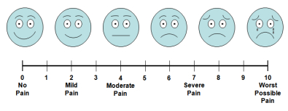
Core Concepts
*Construct: complex psychological concept that cannot be measured directly.
Height ✓, weight ✓, …Pain?
100 meter dash time vs. “Athletic Ability”

Slide 9
Core Concepts
Defining the construct is critical; this is the foundation of a test.
Stakeholders must clearly define the construct for (/with) the test developer.
Disagreement at this level often indicates the need for more than one test.

Slide 10
Core Concepts
Error: Difference between what a test score indicates and the test taker’s actual knowledge and abilities
X = T + E (X= score; T = true score; E = Error)
NO assessment is error free
Sources: Test, Test Taker, Environment
“Pain Scale” vs. 100m dash time

Slide 11
Core Concepts
Validity: The degree to which an assessment measures what it is designed to measure.
Validation is a continuous process
“Sufficient validity evidence” for intended use; depends on testing stakes
Different test uses require additional validation

Slide 12
Core Concepts
Testing of complex psychological concepts is an art and a science.
“Best Practices”
Validation techniques vary depending on sample size (e.g., “confirming” cut scores)
Outcomes may differ by technique

Slide 13
Core Concepts
Review
Psychometrician
Assessment, Test
Construct: Test Foundation
Error: No error-free assessment
Validation: Ongoing; test use and stakes

Slide 14
Assessment Challenges
Poorly defined construct: How much does someone know about… “Culture”?
Concrete (”book”) knowledge about a group’s culture?
Region, country, religious sect, tribe, generation, gender, rural/city, SES?
More expertise More specialization

Slide 15
Assessment Challenges
Knowledge of culture-related concepts? (Anthropology 101 test?)
Cross-cultural communication ability?
Concrete knowledge, CCC principles, foreign language…
Non-cognitive factors: tolerance for ambiguity, openness, empathy, “social intelligence,” + dozens more

Slide 16
Assessment Challenges
How do we measure construct-related variables?
Measurement (in)accuracy
Abstraction increased Error
Assumptions increased Error
Heritage status, overseas experience
Self-assessment notoriously unreliable
“Introspection” abandoned long ago

Slide 17
Assessment Challenges
What is the acceptable level of Error?
“Whenever calculations are done using imprecise numbers, then the numbers resulting from the calculations are also imprecise.”
Testing error increases with the inclusion of each additional variable
X = T + E + E + E + E + E + E + E + E

Slide 18
Assessment Challenges
Algorithms: How are scores weighted?
Are all components equally important?
Are they equally important to all stakeholders?
Different algorithms?
Different assessments?

Slide 19
Assessment Challenges
Weighting algorithm is 99% of the challenge
“Tweaking the algorithm = almost done!”
Start
Research
Development
Algorithm
Done!

Slide 20
Assessment Challenges
More accurate time line:
Start
Research
Development
Algorithm
Done!

Slide 21
Assessment Challenges
Most accurate time line when construct is poorly defined:
Start/ restart
R&D
Algorithm
Algorithm
Algorithm

Slide 22
Assessment Challenges
Assigning final score to a meaningful scale
Picking a scale is Easy (1-3, 1-5, 1-5000)
Assigning scores to a meaningful scale is difficult:
What is a “2” on a 1-5 scale?
Stakeholder needs might vary greatly (FAO vs. SEAL vs. Infantry)

Slide 23
Moving Forward
(*Order may vary)
Find psychometrician(s)
Define construct to be tested
Consensus among stakeholders?
Specify stakeholders’ intended test use
Determine testing stakes (low, med, high)
Informs acceptable error level

Slide 24
Moving Forward
Determine what information is available and how scores will be derived
Determine how scores should be weighted
Develop meaningful scale and ratings
Create and implement validation plan
Finalize development, delivery and test maintenance plan

Slide 25
Conclusion
This is a testing issue, and it requires psychometric support.
Without a solid, psychometrically-sound foundation, even the most elaborate and expensive testing effort will fail.
The fundamental issues discussed today are critical to DoD culture testing and assessment efforts moving forward.

Slide 26
Thank You
Questions or comments:
joeltkoeth.civ@mail.mil

Slide 27
Discussion
Psychometrician(s)
Define construct
Specify test use
Determine stakes
Scoring
Weighting
Scales/ Ratings
Validation plan
Development, Delivery, and Maintenance

